Slide 1
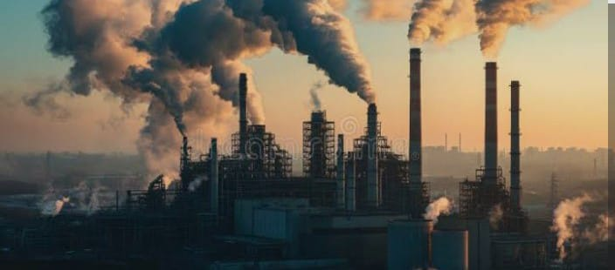
What is industrial pollution
Industrial pollution means harmful waste released from factories
It pollutes air and soil
Factories use chemicals , fuel , and heavy machines that create pollution
It is a major cause of environment damage

Slide 2
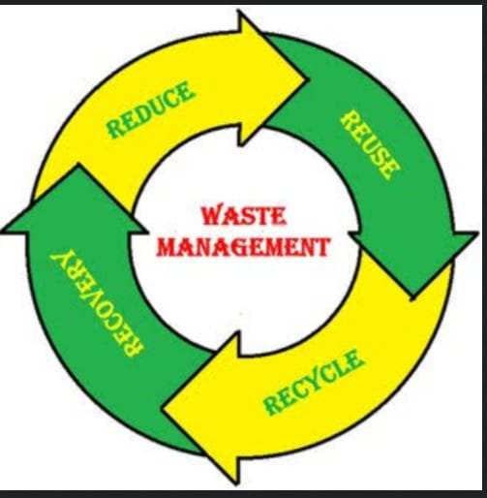
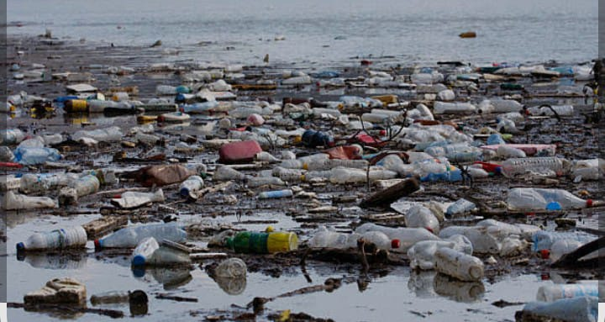
causes :
Burning fossil fuels like coal, gas , and oil
Dumping dirty water into the rivers and lakes
Smokes and toxic gases from factory chimneys
Using old ,unsafe , outdated machines
Lack of proper waste management

Slide 3
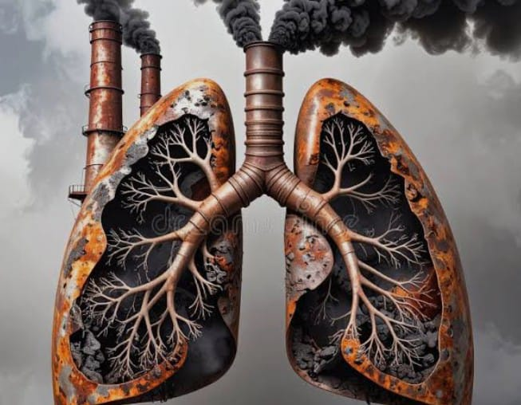
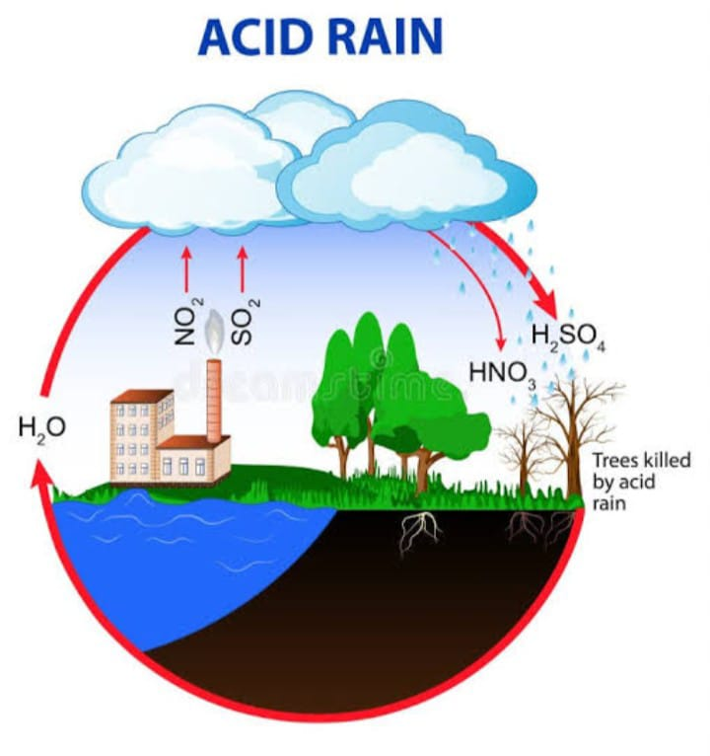
Effects:
Air pollution causes breathing problems and asthma .
Water pollution harms fish and makes water unsafe to drink
Soil pollution reduces soil fertility and affects crop growth.
Can cause acid rain

